Slide 1

xcelerate Test Prep
Revolutionizing standardized test preparation mechanisms
Amit Patankar
Indroneel Bhadra
Anamita Guha

Slide 2
Repeated test taking with limited score analysis
Section by section preparation before test practicing
No real tangible goal and opportunity to improve
Current Standardized Testing Preparation Mechanisms

Slide 3
To completely revolutionize standardized testing practice mechanisms
Our Goal

Slide 4
Provide a platform that:
Our Solution
Tracks and stores performance and scores and missed questions over time
Provides detailed performance analytics that help a user clearly understand their weaknesses
Allow users to exploit complex analytics to improve effectively and efficiently

Slide 5
Test preparation centers teach basic concepts on a superficial level
Current Procedure
They provide students with a large database of tests that they grade and chart their score over time
Students take tests aimlessly expecting improvement ignorant of true vulnerabilities
Gives users a full understanding of vulnerabilities from test types and difficulty to fatigue and inconsistency
Allows users to see huge returns on scores by studying smarter rather than longer
Transforms test preparation industry from brute force methodology to efficient data analysis based improvement
Our Solution

Slide 6
Test preparation centers teach basic concepts on a superficial level
Current Procedure
They provide students with a large database of tests that they grade and chart their score over time
Students take tests aimlessly expecting improvement ignorant of true vulnerabilities
Our Solution
Transforms test preparation industry from brute force methodology to efficient data analysis based improvement
Allows users to see huge returns on scores by studying smarter rather than longer
Gives users a full understanding of vulnerabilities from test types and difficulty to fatigue and inconsistency

Slide 7
It will help you study more effectively by allowing a student to focus their attention on their weak areas
Why It Works

Slide 8
Current Development Plan (Completed)
Conducting surveys of standardized test takers and gauged interest
Revision 1.0
GUI development
Website to highlight strengths

Slide 9
Current Development Plan (In Progress)
Revision 2.0
A possible website interface that allows remote push and pull
Automatic report email interface
Focus groups showing analytic progress

Slide 10
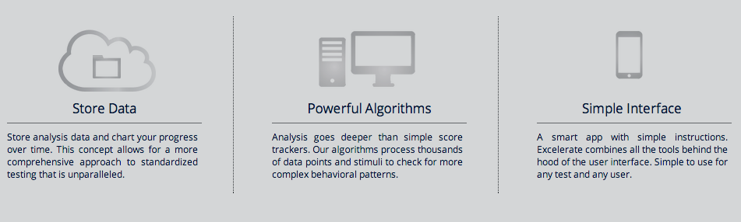
Our Pillars

Slide 11
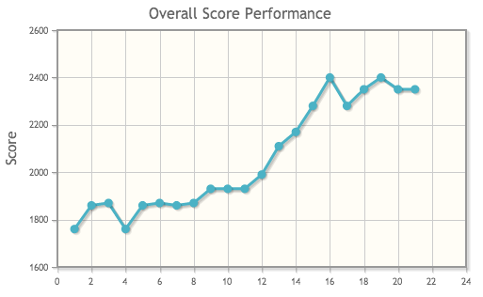
Store Data

Slide 12
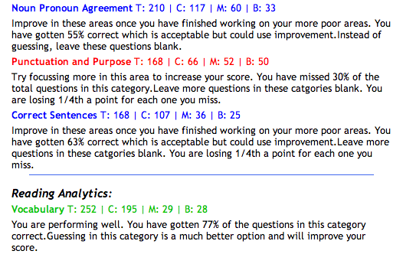
Powerful Algorithms

Slide 13
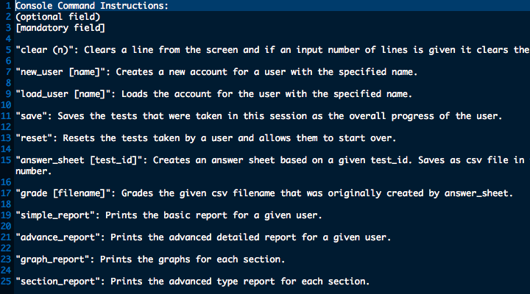
Simple Interface

Slide 14
Multiple report options that show intricate graphs and provide helpful advice
Current Features
Simple interface that has been bug tested and has virtually no use crash rate
Powerful algorithms that show weakness, identify strengths and test for other dimensions
Tooltip reports on graphs for tests
Dated tests to show time analysis and breaks in performance over lack of testing
Target school score calculator that shows progress in relation to school applicant scores
Future Features

Slide 15
Meet The Team

Slide 16

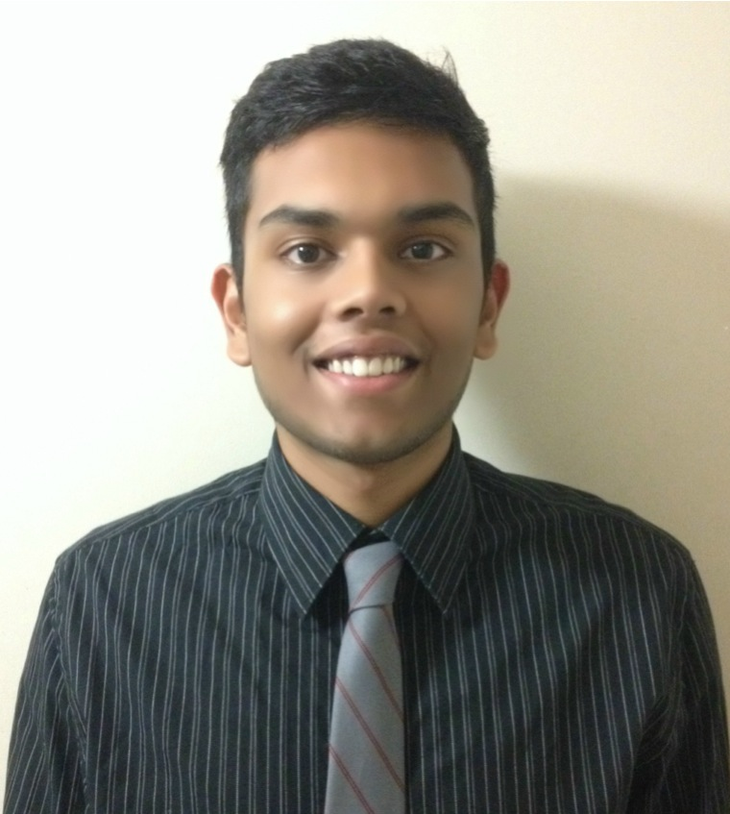

4th Year Computer Engineering major at UC Davis
Amit Patankar
Extensive experience in software development
Project manager in marketing
Indroneel Bhadra
Anamita Guha
Experience in data parsing, algorithms, and software
Extensive start up experience in Silicon Valley
3rd Year EECS major at UC Berkeley
4th Year Cognitive Science major at UC Berkeley
Experience in cognitive development
Standardized testing practice with SAT and professional exams

Slide 17
xcelerate Test Prep
Revolutionizing standardized test preparation mechanisms
Thank you for your time!

